Slide 1
Table 1 1. Find the top 5 cities with the highest average number of bedrooms per property.

Slide 2
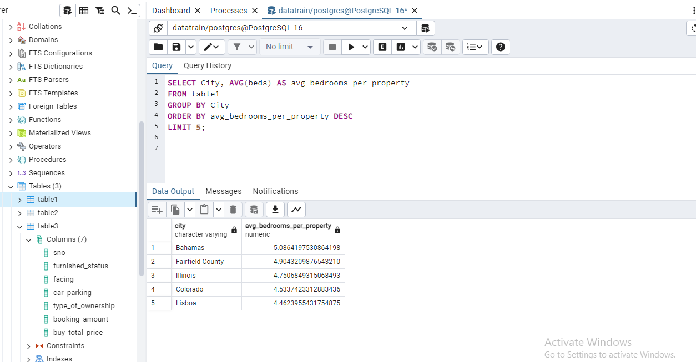

Slide 3
Table 1 2. Retrieve properties with balconies, sorted by the number of bedrooms in descending order.

Slide 4
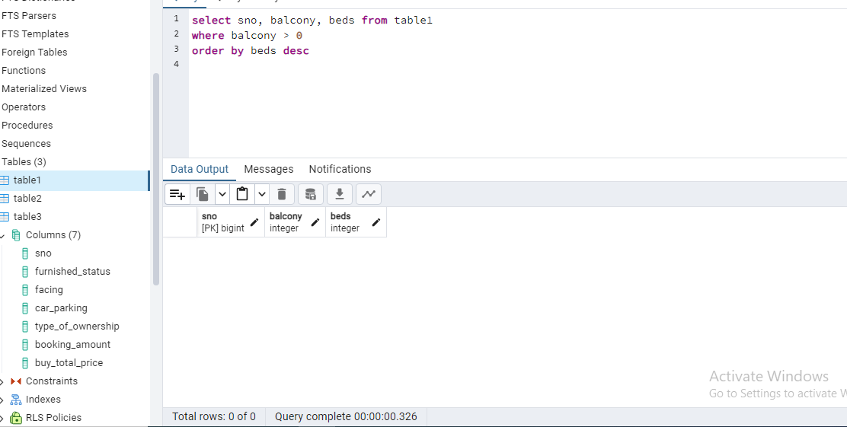
*( Because there is not feature of Balcony on Christie’s Real Estate )

Slide 5
Table 1 3. Count the number of properties in each city.

Slide 6
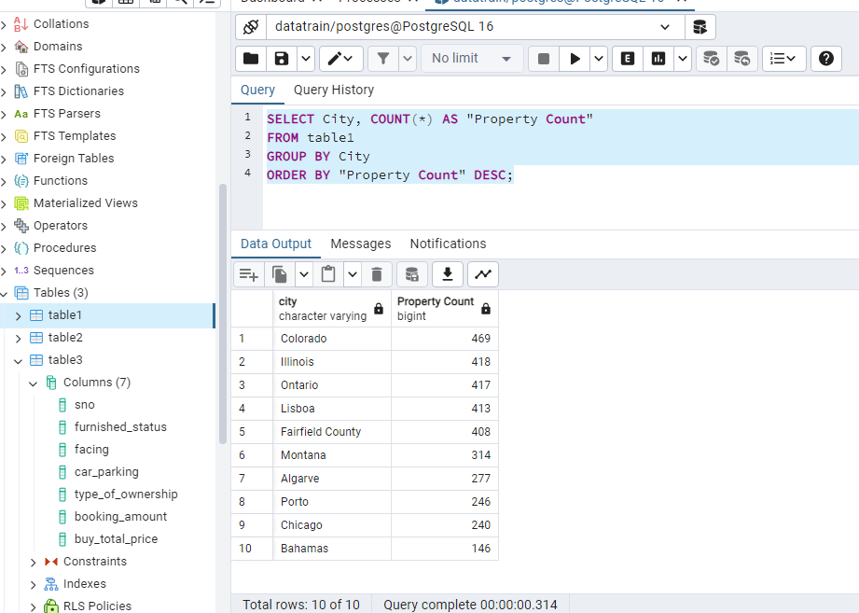

Slide 7
Table 1 4. Retrieve all properties with at least 3 bedrooms and 2 bathrooms.

Slide 8
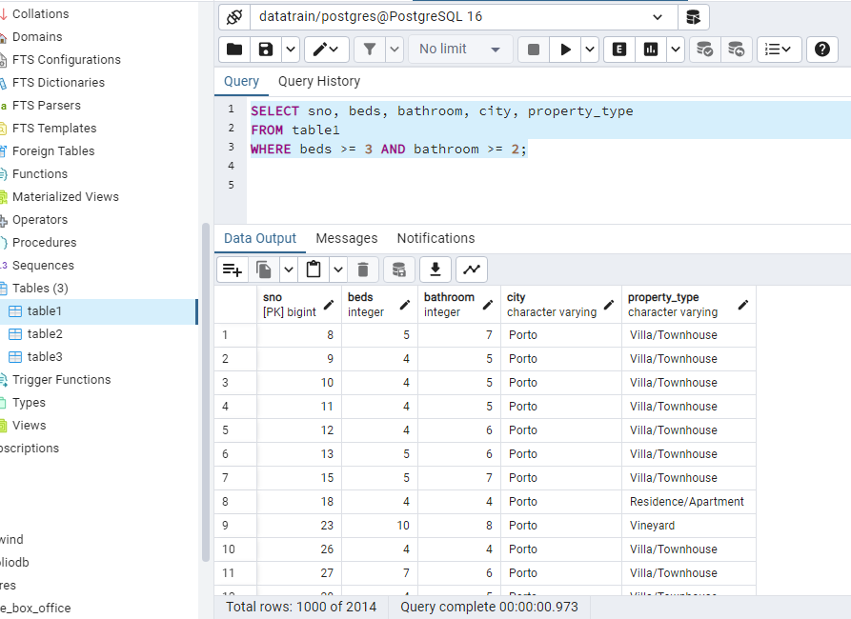

Slide 9
Table 1 5. Find properties in a specific state with a certain landmark. (take state and landmark on your own )

Slide 10
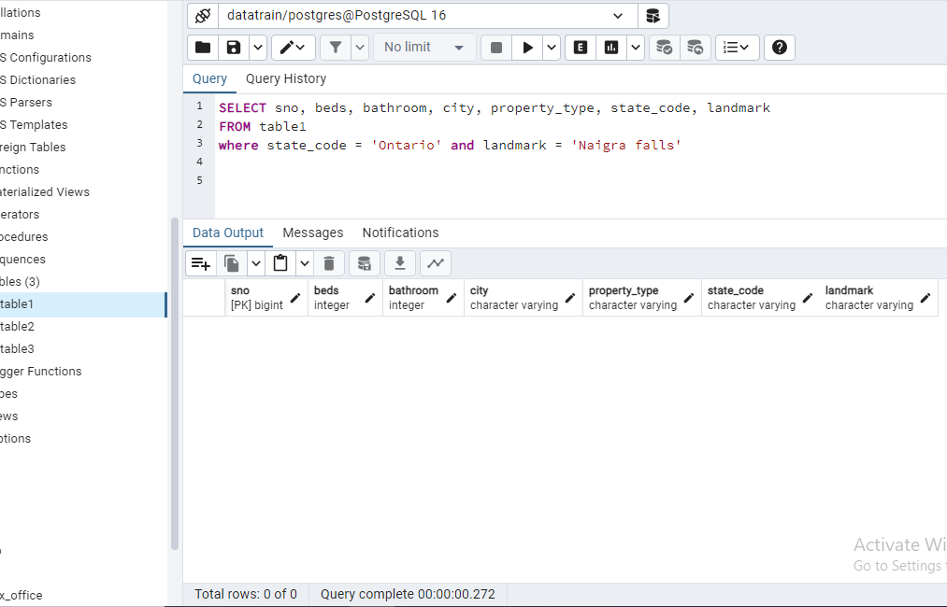

Slide 11
Table 2 1. Calculate the average price per square foot for properties built before 2010.

Slide 12
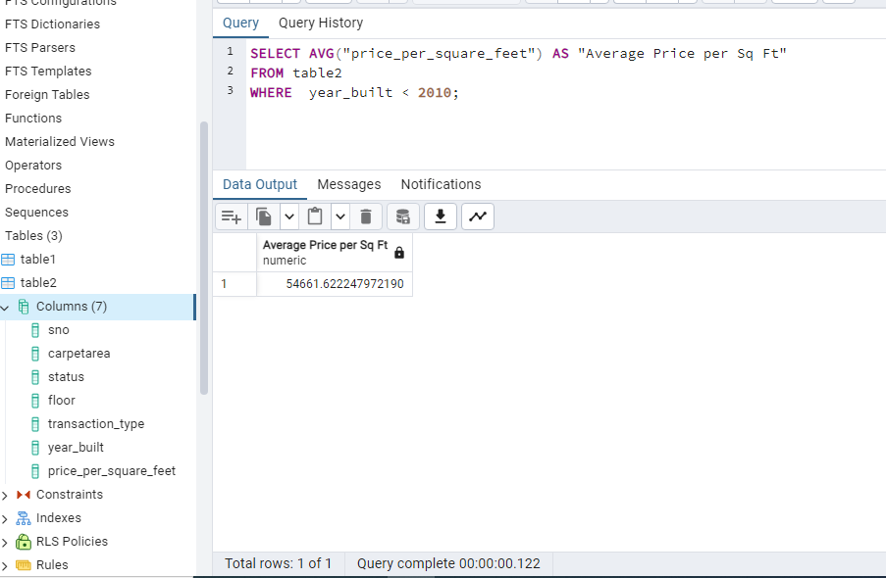

Slide 13
Table 2 2. Find the total number of properties on each floor..

Slide 14
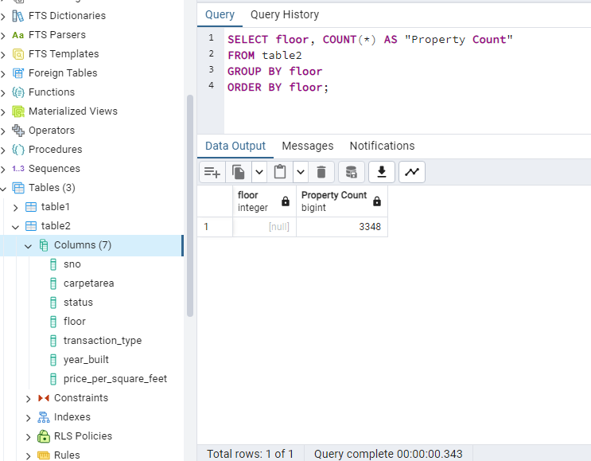
*( No floor feature was present on Christie’s Real Estate )

Slide 15
Table 2 3. Retrieve properties with a carpet area greater than 1000 square feet and a status of 'Under Construction'.

Slide 16
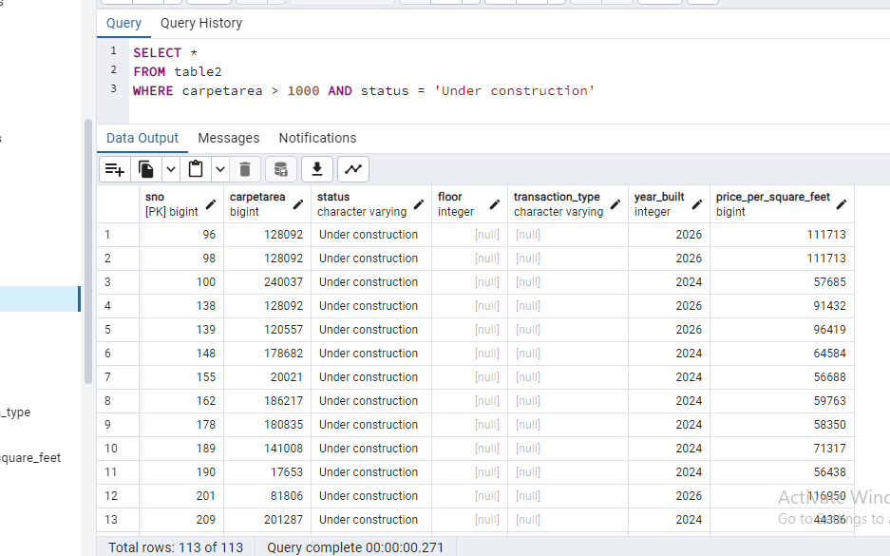

Slide 17
Table 2 4. Calculate the average price per square foot for each transaction type..

Slide 18
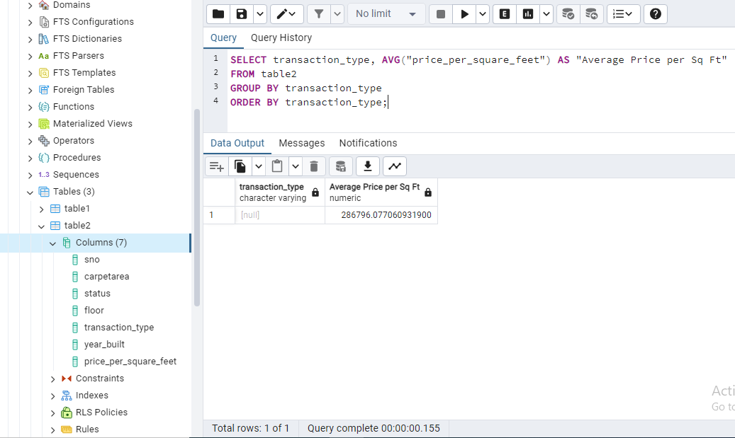
*( No transaction feature was present on Christie’s Real Estate )

Slide 19
Table 2 5. Find the properties with the highest price per square foot, sorted in descending order.

Slide 20
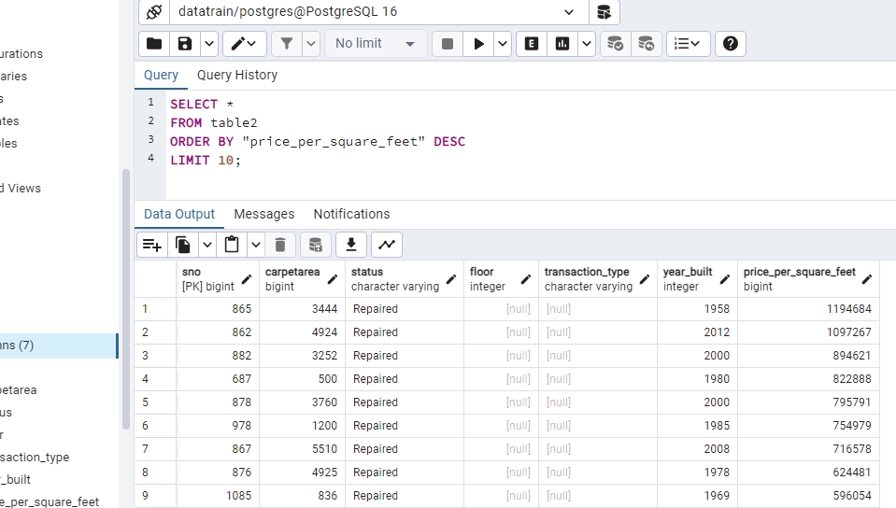

Slide 21
Table 3 1.Retrieve all properties with a furnished status of 'Fully Furnished' and a facing direction of 'East'

Slide 22
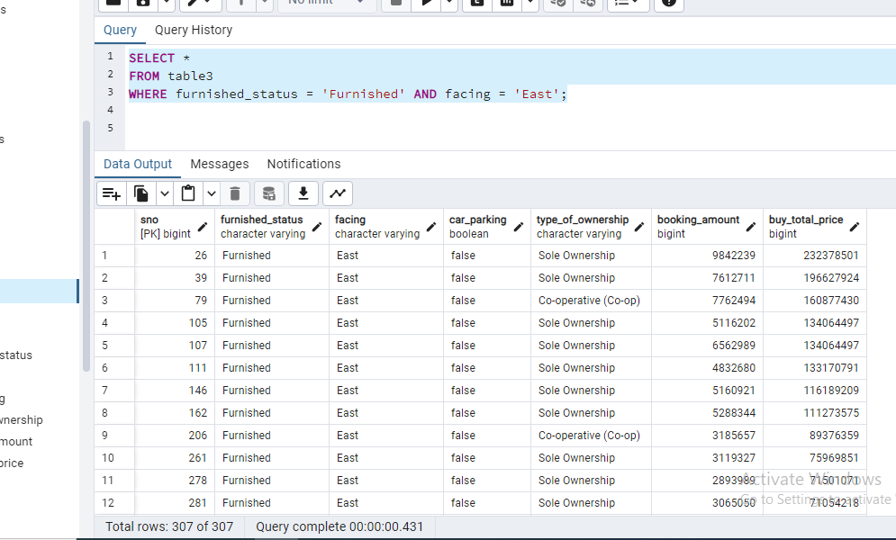

Slide 23
Table 3 2. Calculate the average booking amount for properties with and without car parking

Slide 24
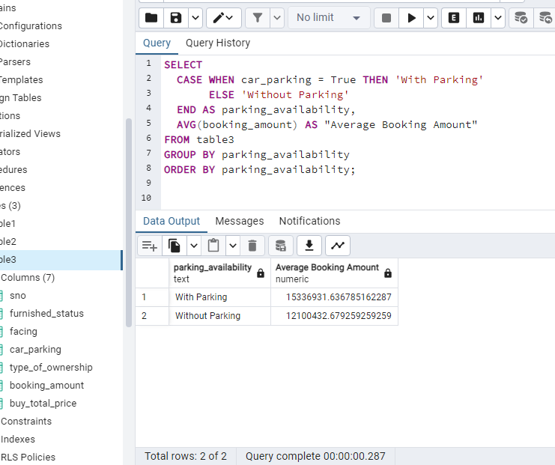

Slide 25
Table 3 3. Find the total price of properties with different types of ownership

Slide 26
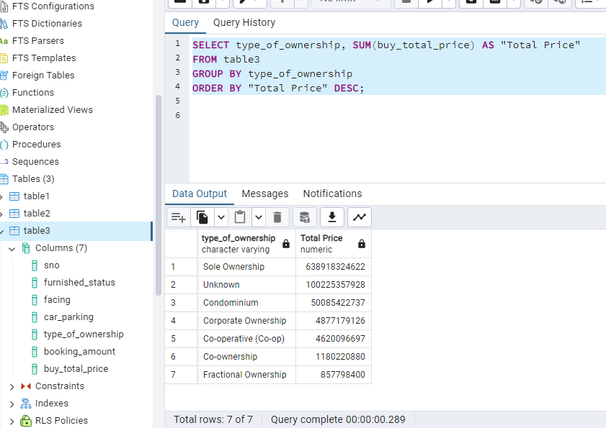

Slide 27
Table 3 4. Retrieve properties with a booking amount greater than 50000 and a furnished status of 'Semi Furnished'

Slide 28
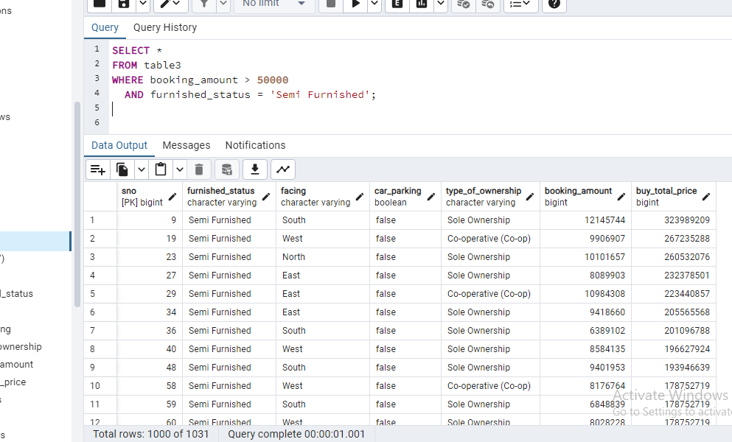

Slide 29
Table 3 5. Find the property with the highest booking amount.

Slide 30
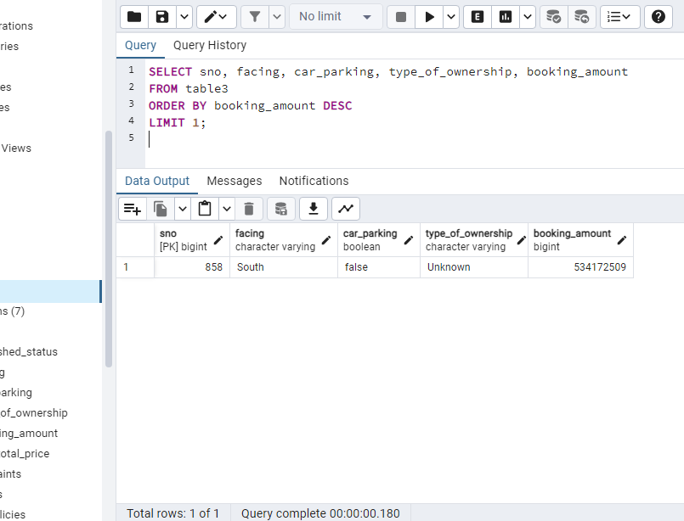

Slide 31
Join SQL Queries using all 3 tables
Retrieve properties from table1 that have a higher price per square foot than the average price per square feet

Slide 32
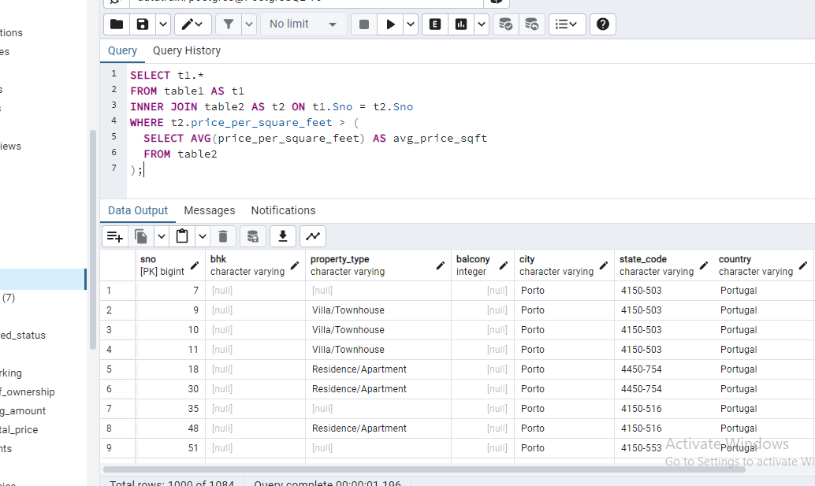

Slide 33
Join SQL Queries using all 3 tables
2. Find the properties in table1 that are located in cities where the average price per square foot in table2 is higher than the overall average price per square foot.

Slide 34
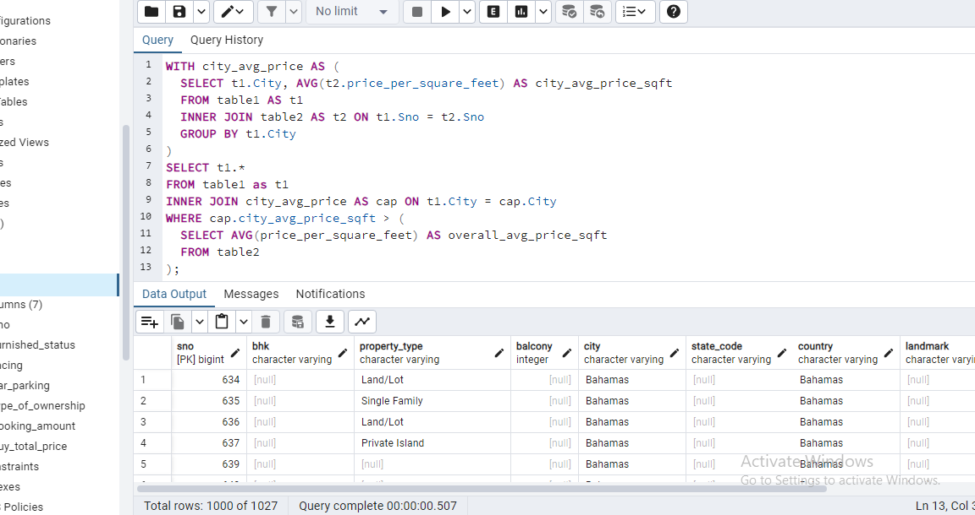

Slide 35
Join SQL Queries using all 3 tables
3. Retrieve properties from table1 with a certain landmark that have a lower price per square foot than the average price per square foot for properties with the same landmark in table2. (Choose landmark on our own)

Slide 36
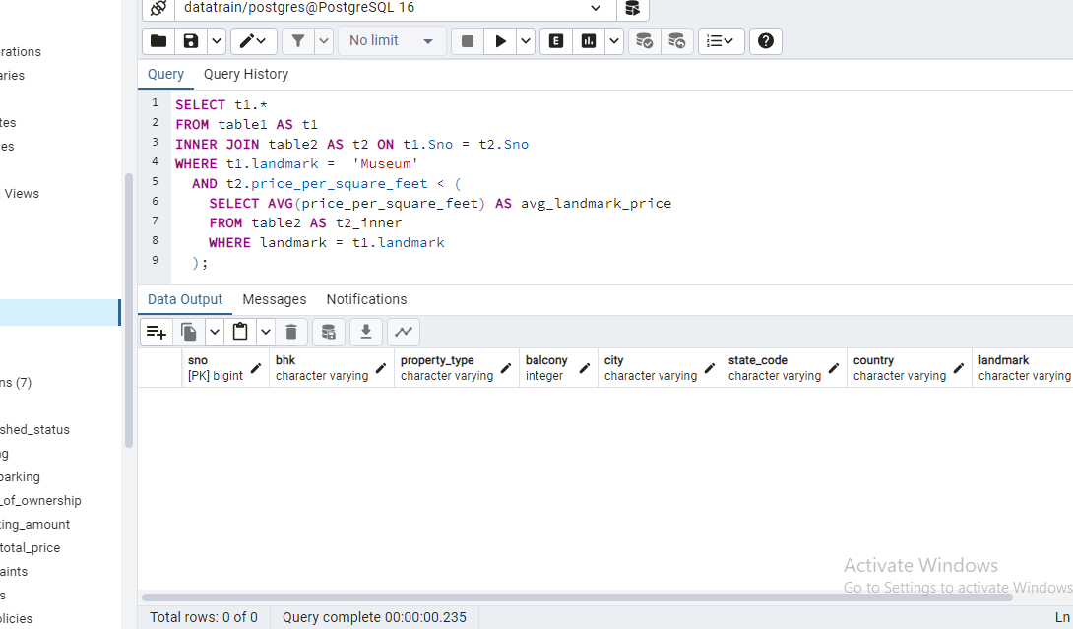

Slide 37
Join SQL Queries using all 3 tables
4. Retrieve properties from table2 with a price per square foot higher than the average booking amount in table3

Slide 38
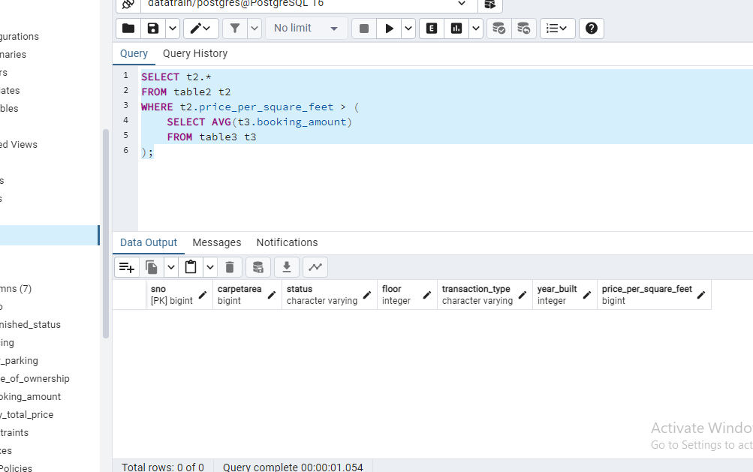

Slide 39
Join SQL Queries using all 3 tables
5. Count the number of properties in table2 with more bedrooms than the maximum number of bedrooms in table3.
( wrong question )

Slide 40
Join SQL Queries using all 3 tables
6. Find the cities where the average booking amount in table3 is higher than the overall average booking amount, and retrieve properties from table1 located in those cities.

Slide 41
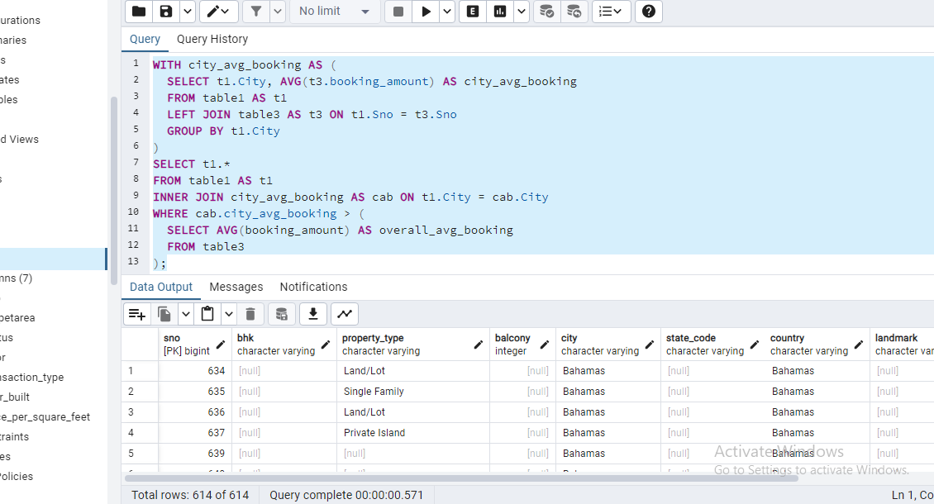

Slide 42
Join SQL Queries using all 3 tables
7. Retrieve properties from table1 with a furnished status of 'Unfurnished' and a facing direction that does not exist in table3

Slide 43
